Slide 1

CSE-4078 Mobile Application Development
Lectures – Week 2
Sara Masood

Slide 2
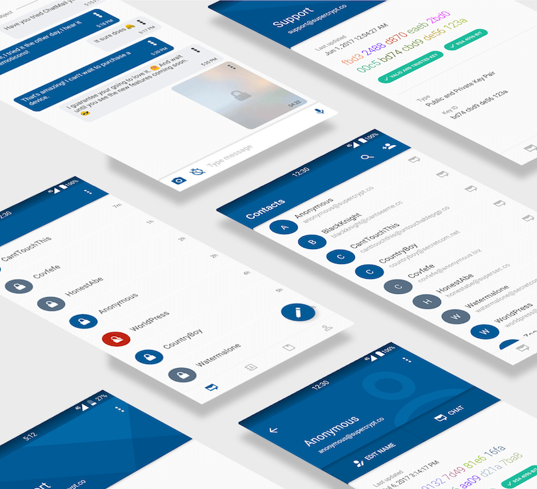
UI Tool kit
Widgets
Widget containers

Slide 3
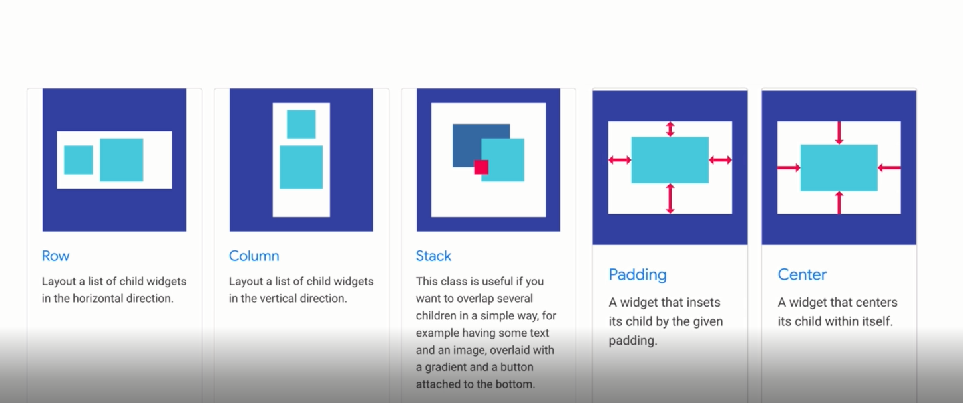
UI tool kit contains widgets

Slide 4
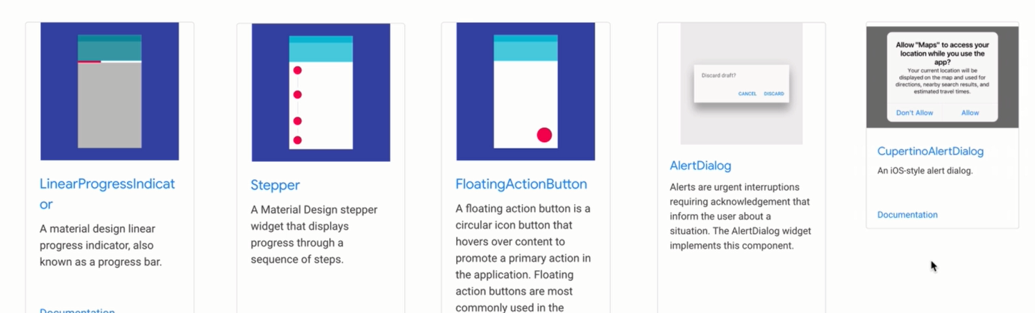
Widgets

Slide 5
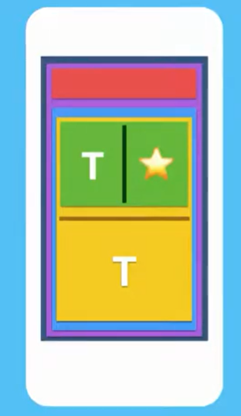
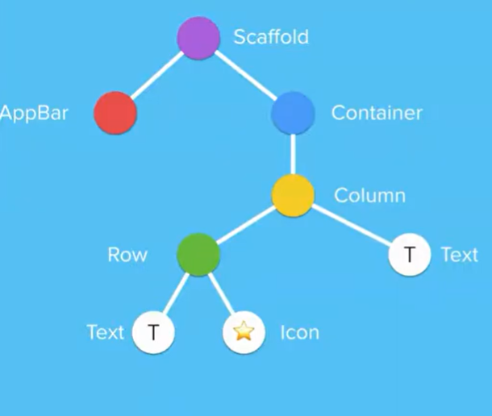
The anatomy of a Flutter application

Slide 6
The anatomy of a Flutter application
Scaffold( appBar: AppBar(), body: Container( child: Column( children: [ Row( Text(""), Icon(""), ), Text("") ], ), ), ),);

Slide 7
Material Design
Material is an adaptable system of guidelines, components, and tools by Google that support the best practices of user interface design
Homepage - Material Design

Slide 8
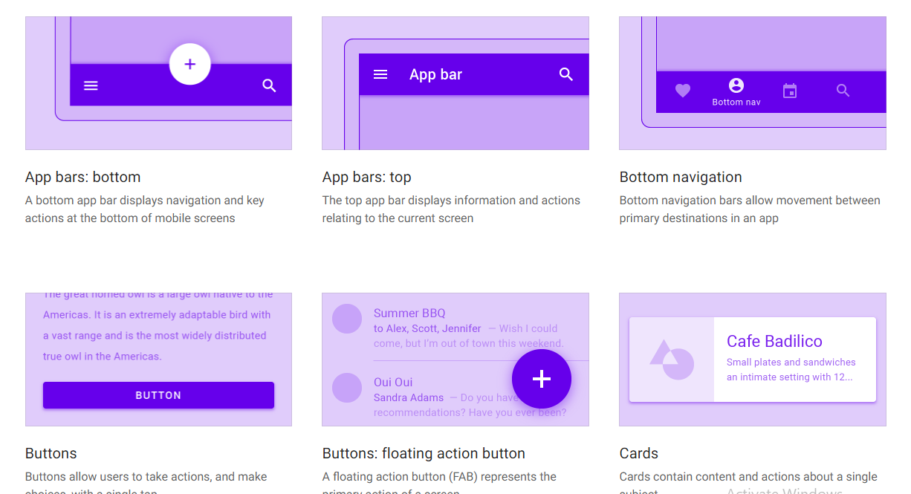
Material Components

Slide 9
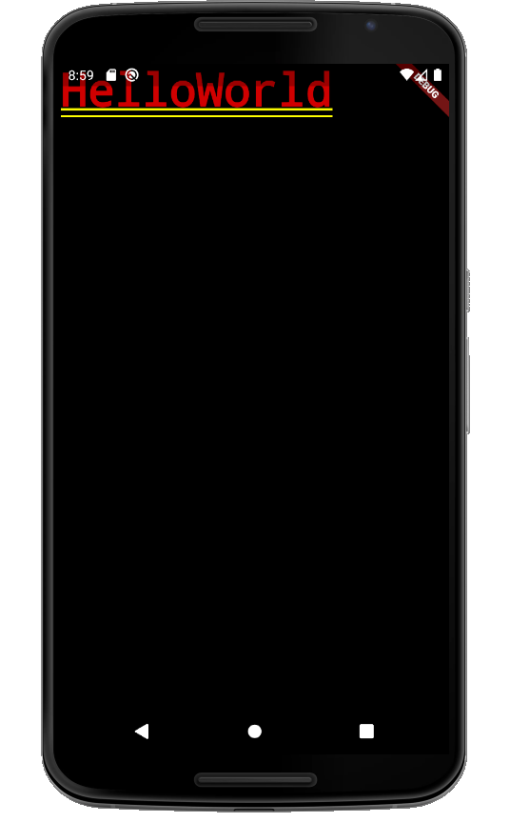
Material Design
void main() {
runApp(
const MaterialApp(
home: Text("HelloWorld"),
),
);
}

Slide 10
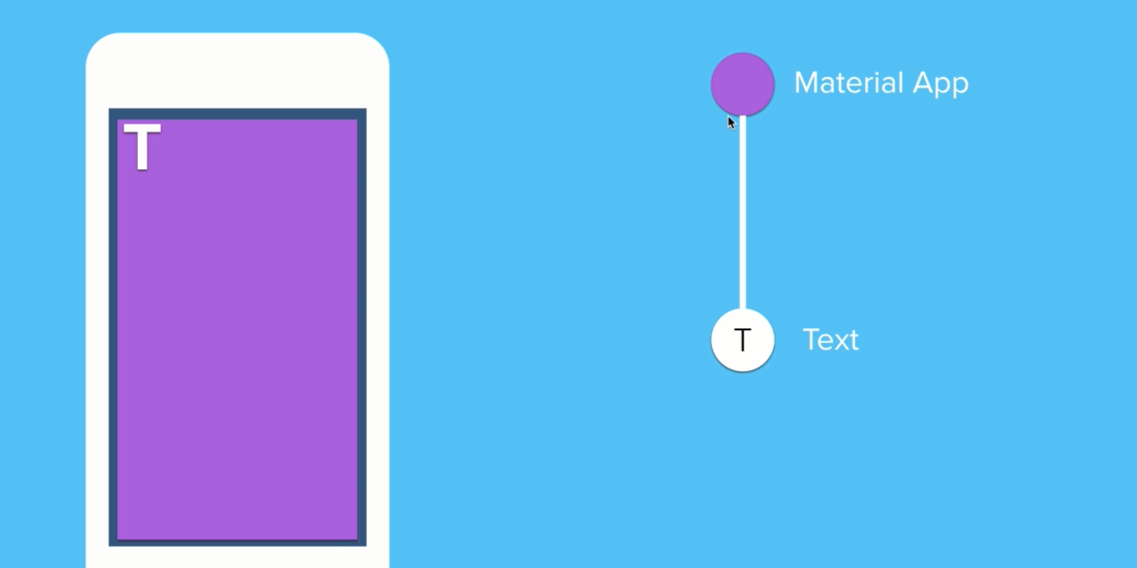
Widget Tree

Slide 11
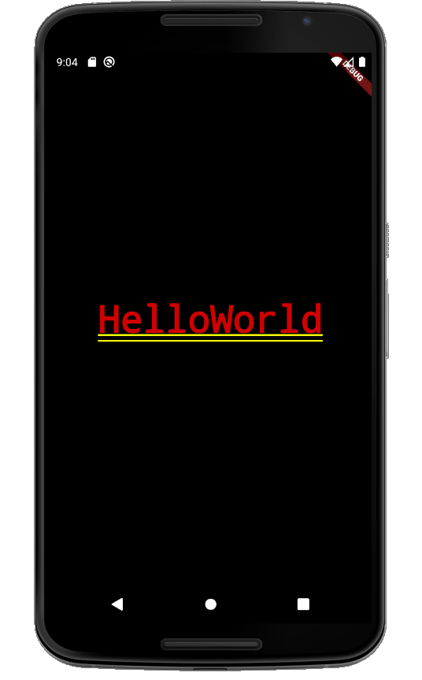
Material Design - Implementation
void main() {
runApp(
const MaterialApp(
home: Center(
child: Text("HelloWorld"),
),
),
);
}

Slide 12
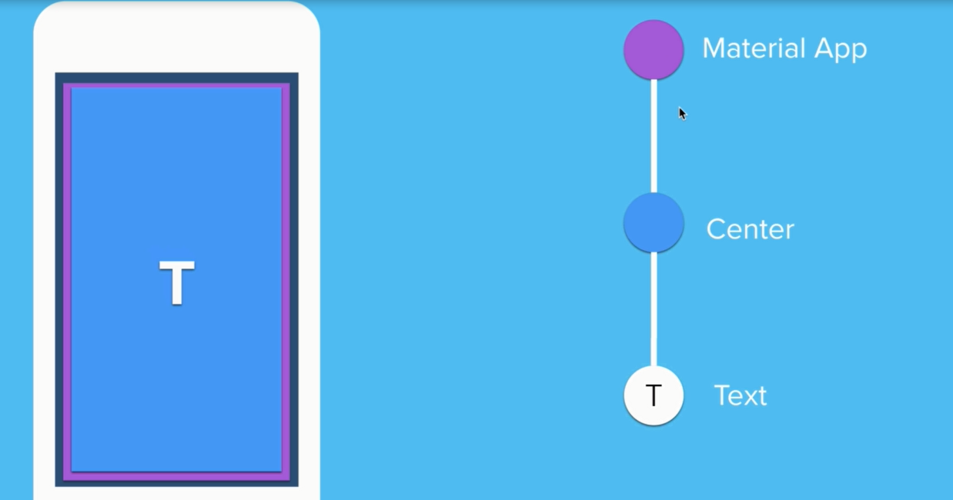
Widget Tree

Slide 13
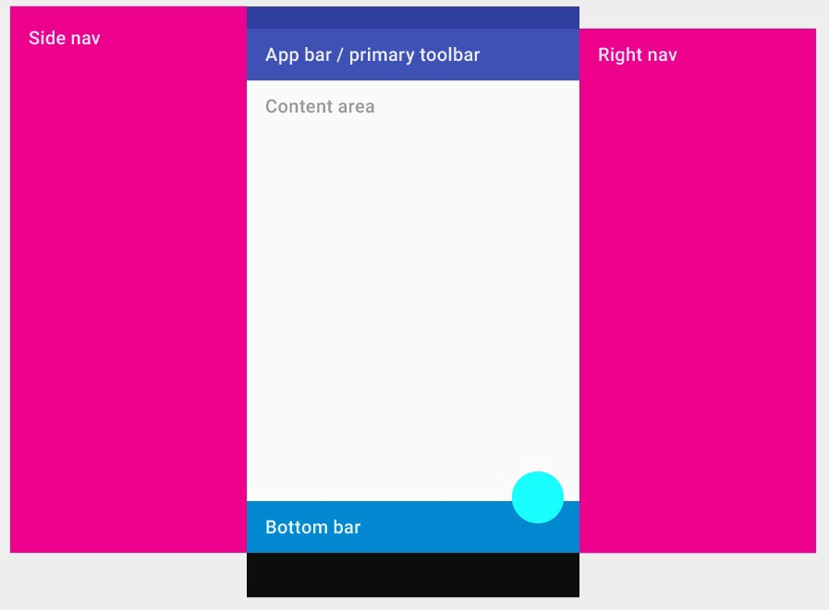
Scaffold
Visual layout of Scaffold

Slide 14
Scaffold
Scaffold handles the following Widgets in it. That is, it can pack all the widgets into it.
AppBar
Floating Action Button
Bottom Navigation Bar
Persistent Footer Buttons
Recommended read
Scaffold class - material library - Dart API (flutter.dev)
App bars: top - Material Design

Slide 15
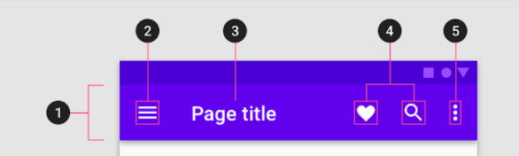
Scaffold – AppBar
Container (optional)
Navigation icon (optional)
Title (optional)
Action items (optional)
Overflow menu (optional)

Slide 16
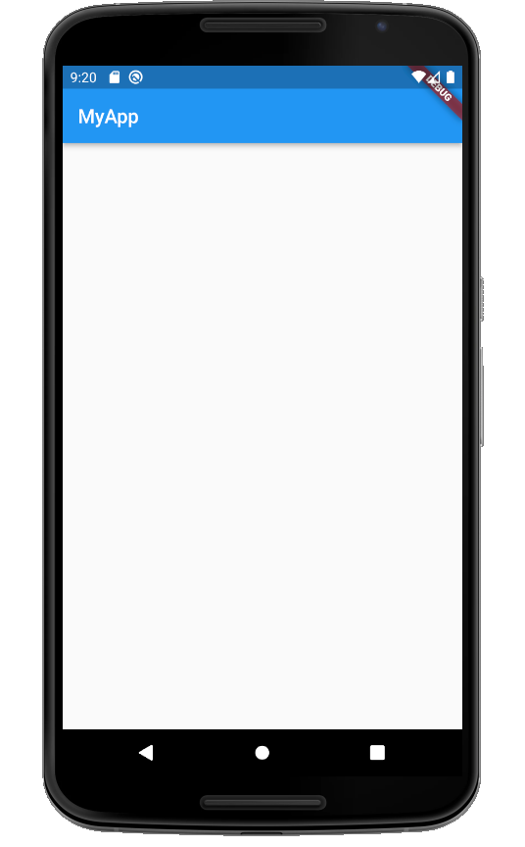
AppBar - Implementation
void main() {
runApp(
MaterialApp(
home: Scaffold(
appBar: AppBar(
title: Text("MyApp"),
),
),
),
);
}

Slide 17
Appbar - actions property
A list of Widgets to display in a row after the title widget.
actions: <Widget>[
IconButton(
icon: Icon(
Icons.settings,
color: Colors.white,
),
onPressed: () {
// do something
},)],

Slide 18
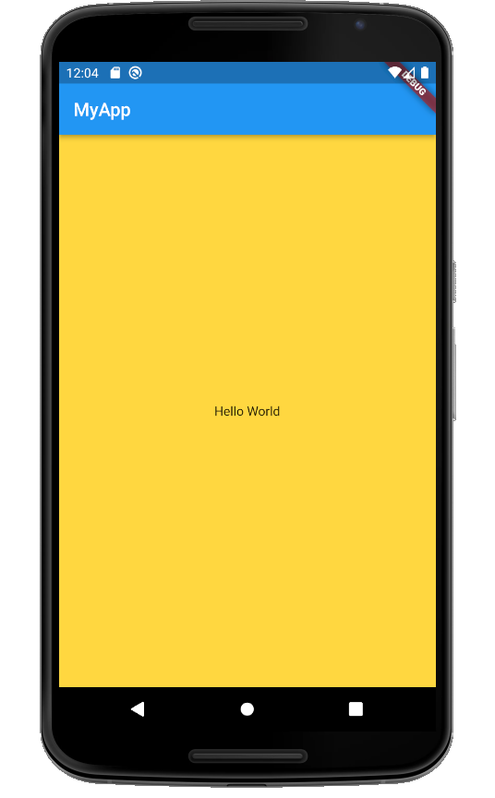
Scaffold - Body
MaterialApp(
home: Scaffold(
appBar: AppBar(
title: const Text("MyApp"),
),
body: const Center(
child: Text("Hello World"),
),
backgroundColor: Colors.amberAccent,
),
),

Slide 19
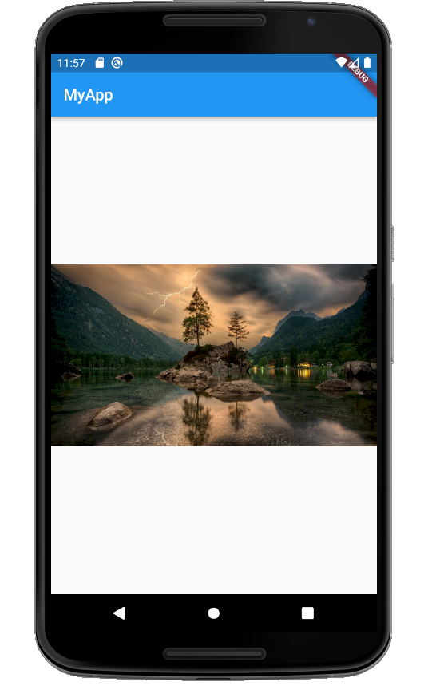
Scaffold - Body
MaterialApp(
home: Scaffold(
appBar: AppBar(
title: const Text("MyApp"),
),
body: const Center(
child: Image(
image: NetworkImage("URL"),
),
),
),
),

Slide 20
Enriching the body - Image
Image Widget
Several constructors are provided for the various ways that an image can be specified:
new Image, for obtaining an image from an ImageProvider.
new Image.asset, for obtaining an image from an AssetBundle using a key.
new Image.network, for obtaining an image from a URL.
new Image.file, for obtaining an image from a File.
new Image.memory, for obtaining an image from a Uint8List.
Image class - widgets library - Dart API (flutter.dev)

Slide 21
Image – Network Image
const Image(
image: NetworkImage('https://flutter.github.io/widgets/owl.jpg'),
)
Image.network('https://flutter.github.io/assets/widgets/owl-2.jpg')

Slide 22
Image – Asset Image
Creates a widget that displays an ImageStream obtained from an asset bundle. The key for the image is given by the name argument.
const Image(
image: AssetImage('images/cat.png')),
)
Image.asset('images/cat.png')

Slide 23
Including Asset
pubspec.yaml manifest
name: my_awesome_application
flutter:
assets:
- images/hamilton.jpeg
- images/lafayette.jpeg

Slide 24
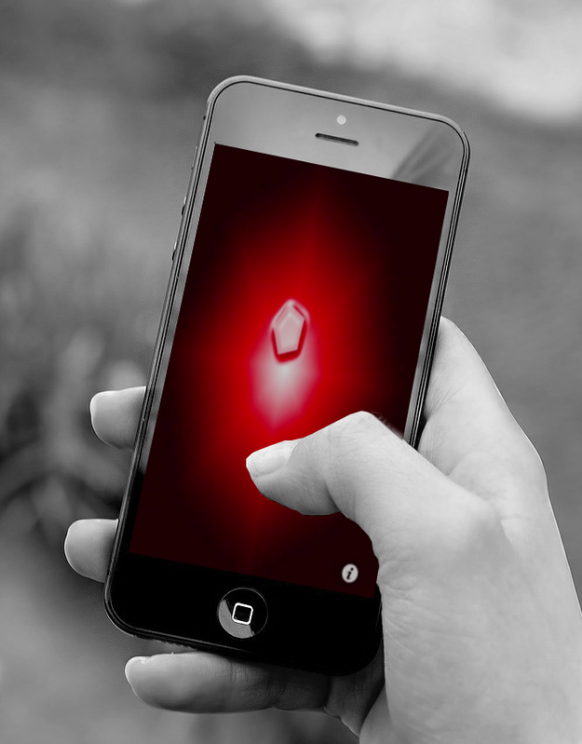
I’m rich app
I Am Rich is an iOS application developed by Armin Heinrich
The screen only contains a glowing red gem and an icon that, when pressed, displays the following mantra in large text
I am rich
I deserv it
I am good,
healthy & successful
Priced at US$999.99

Slide 25
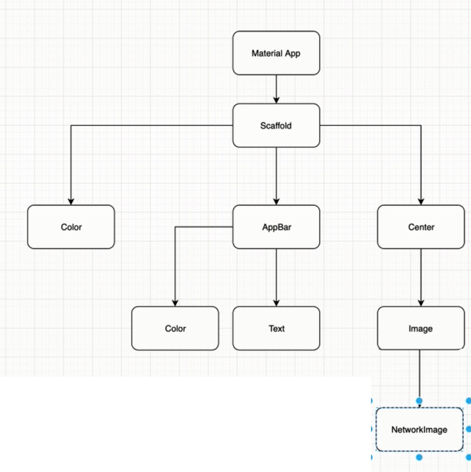
I’m rich app

